Slide 1
LLAS eLearning Symposium
Training public service interpreters at a distance –
Possible or impossible?
Nathalie Thorne MA Hons
School of Languages, Leeds Met

Slide 2
“Teaching Interpreting in Cyberspace: The Answer to All Our Prayers?” Hanne Skaaden and Maria Wattne
Training public service interpreters at a distance
Possible or impossible?

Slide 3
What have others done? Training needs of the industry Our model Issues to overcome Language Assessment Synchronous vs asynchronous Language practice and practical classes Key design points Summary of training plan
Training public service interpreters at a distance
Possible or impossible?

Slide 4
Virtual conference interpreting classes SCICrec Blackbox Interpreting software IVY project DPSI online DPSI via distance learning Glendon University Community and Conference Interpreter training
Training public service interpreters at a distance
Possible or impossible?

Slide 5
Training needs of the industry Unavailability of training in key, demanded languages Schedules of existing training opportunities Lack of directed CPD courses for interpreters
Training public service interpreters at a distance
Possible or impossible?

Slide 6
Plan of Action Level 4: Vocational Certificate in Interpreting (45 credits) Level 5: Vocational Diploma in Interpreting (45 credits) Level 6: Professional Diploma in Public Service Interpreting (40 credits) Level 7: Advanced Professional Diploma in Public Service Interpreting (40 credits). Delivered via MOODLE platform asynchronously
Training public service interpreters at a distance
Possible or impossible?

Slide 7
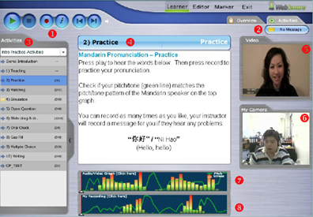
Training public service interpreters at a distance
Possible or impossible?
Language assessment/practice
Webswami
Articulate
SCICrec

Slide 8
Training public service interpreters at a distance
Possible or impossible?
Synchronous vs Asynchronous
Flexibility
Options
Use of digital media in place of live role plays.

Slide 9
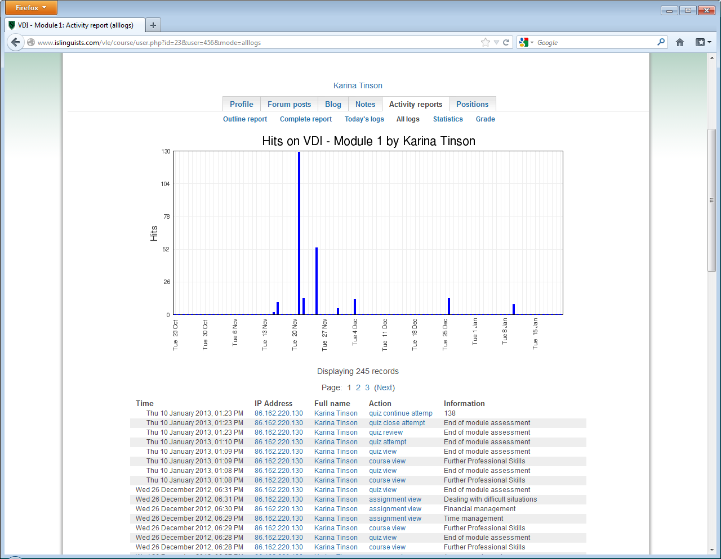
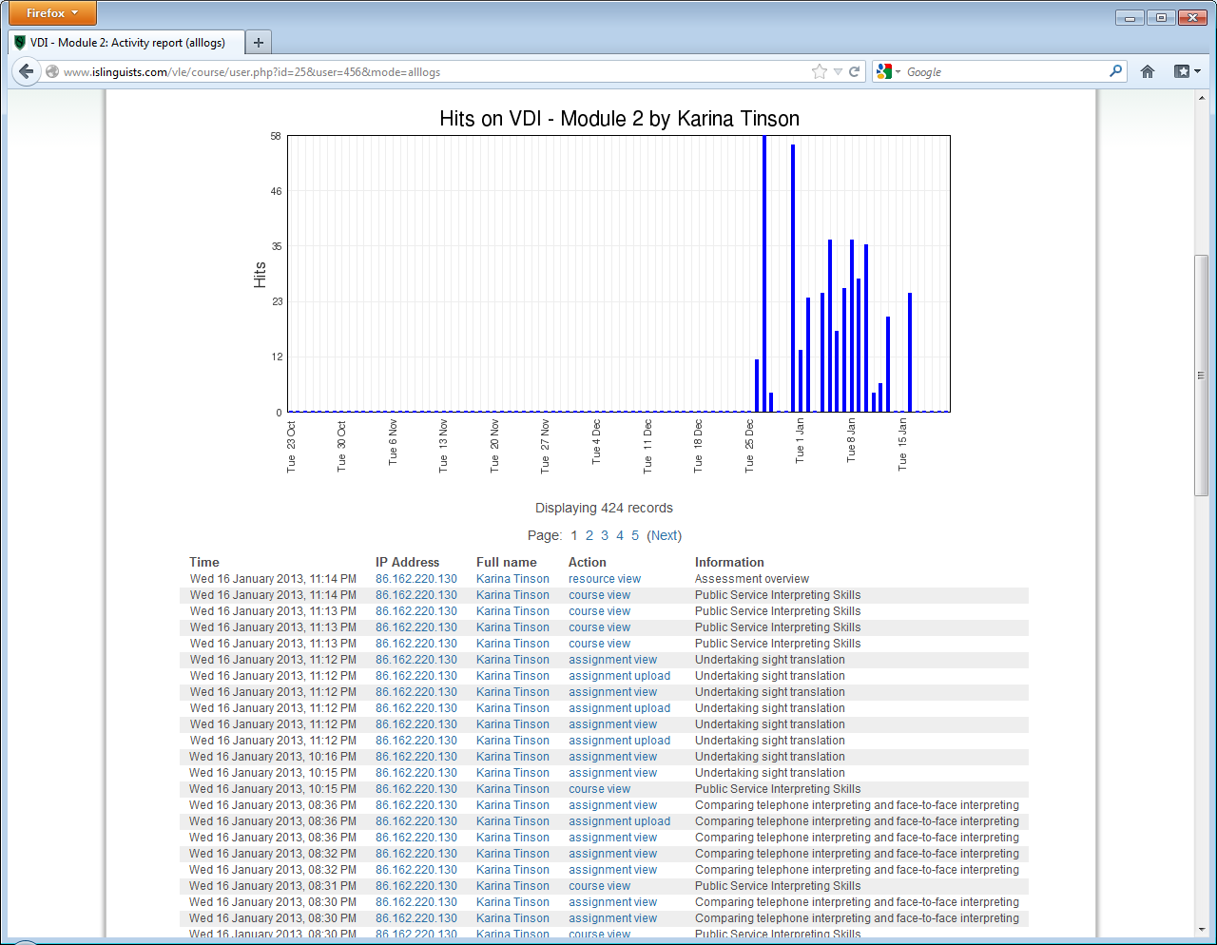
Training public service interpreters at a distance
Possible or impossible?
Student response and engagement

Slide 10
Training public service interpreters at a distance
Possible or impossible?
Key design points Clear use of Modules, Units, Lessons within MOODLE
Signposting using colours and instruction boxes
Font choice – Georgia
A serif font specifically designed for online use
Use of an online Reflections Workbook module overlay in Moodle

Slide 11
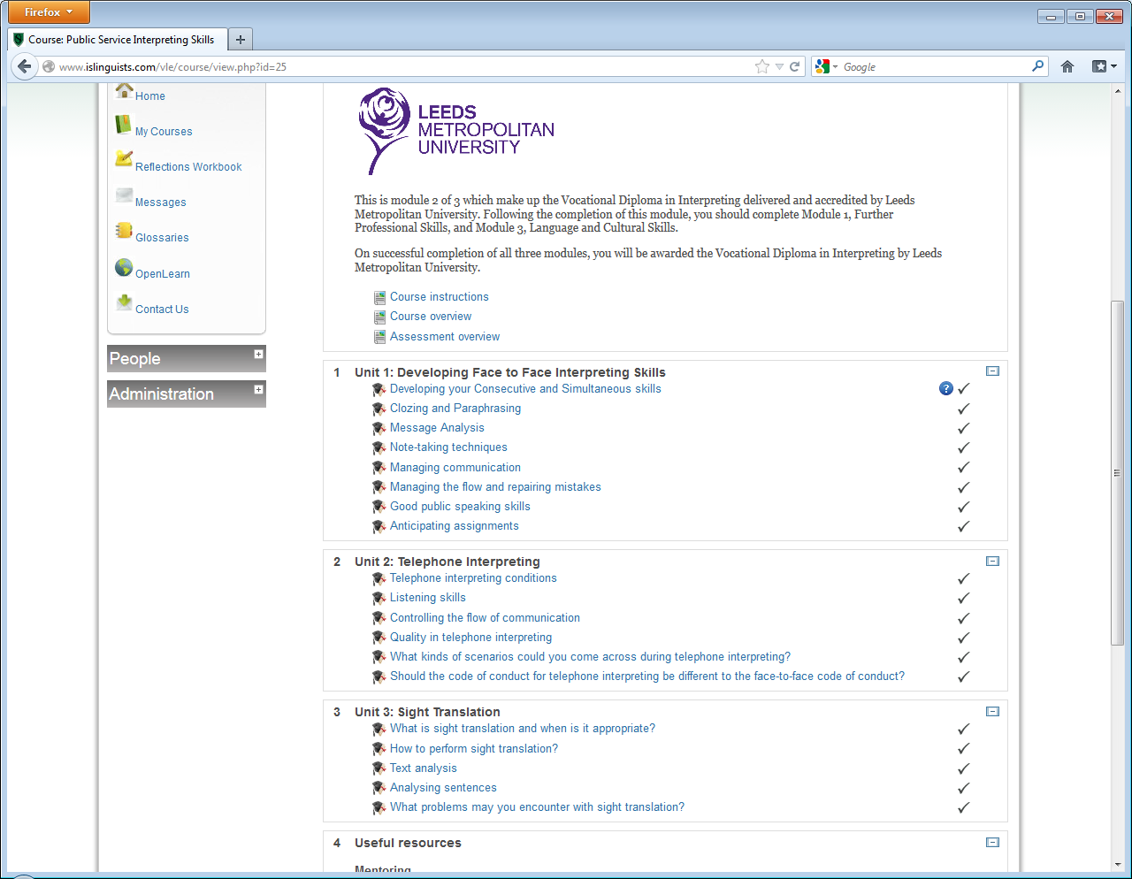
Training public service interpreters at a distance
Possible or impossible?
Layout

Slide 12
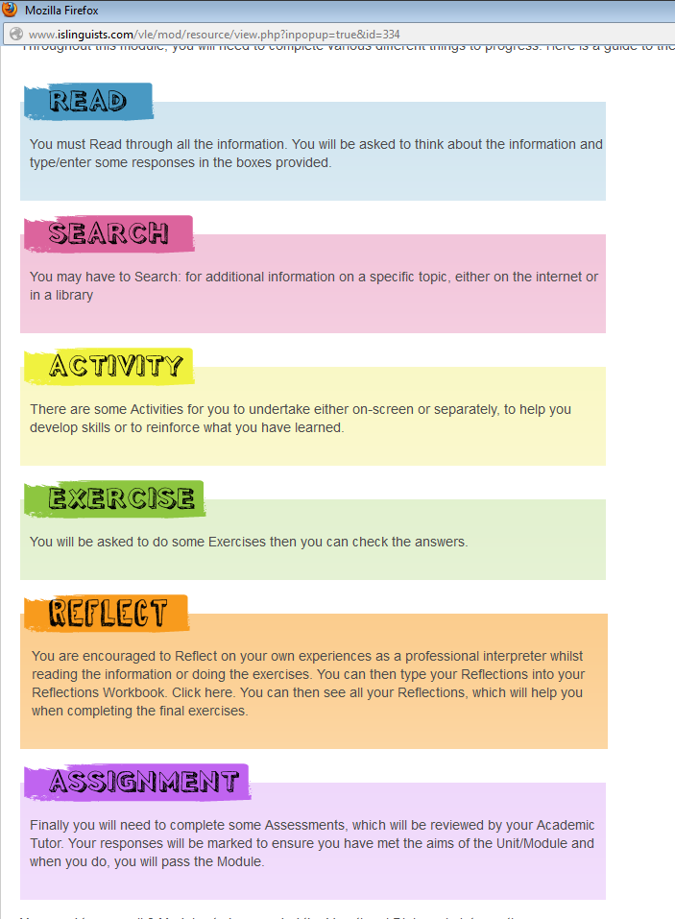
Training public service interpreters at a distance
Possible or impossible?
Signposts

Slide 13
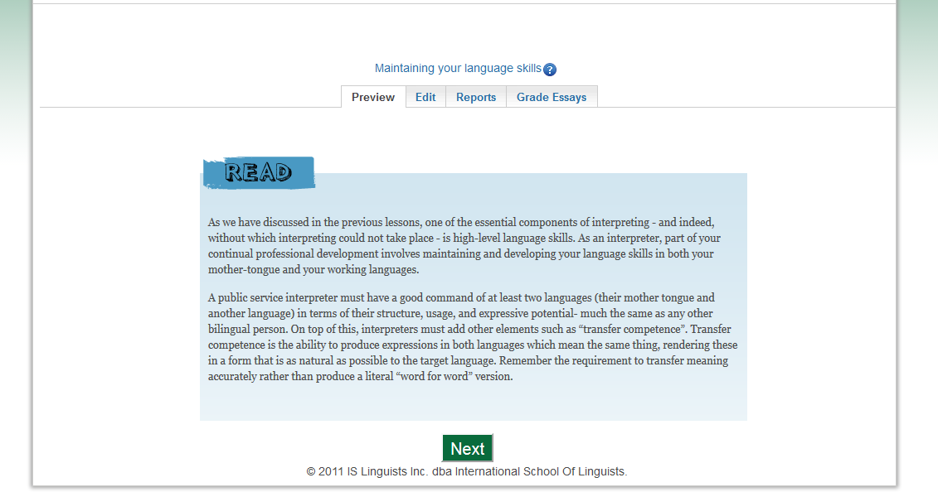
Training public service interpreters at a distance
Possible or impossible?
Font

Slide 14
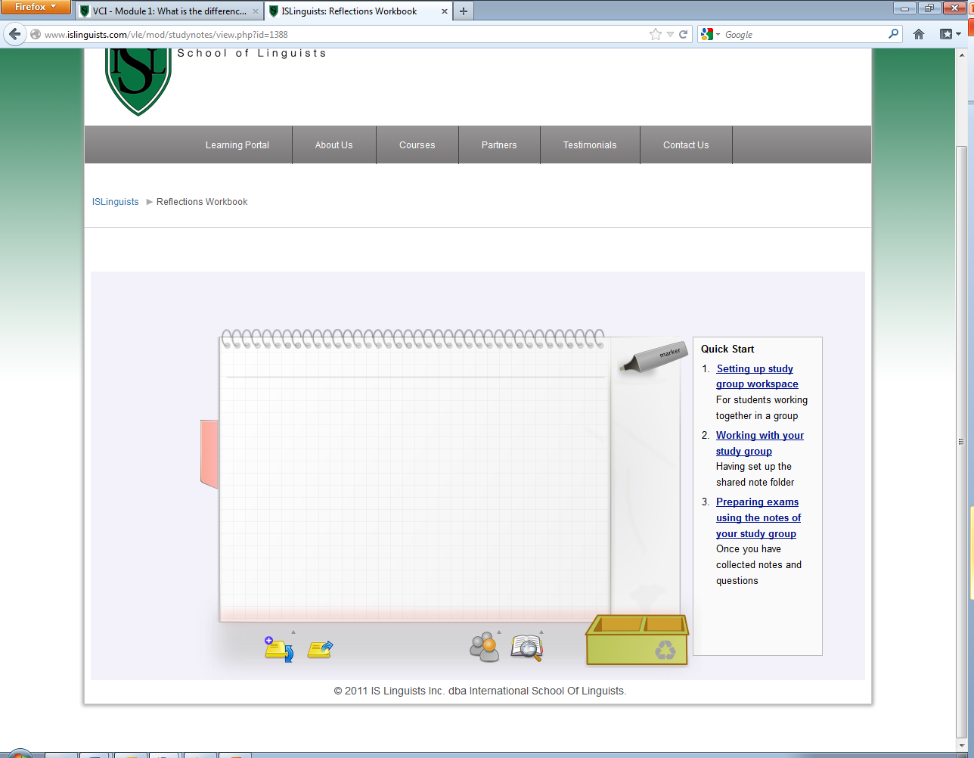
Training public service interpreters at a distance
Possible or impossible?
Online reflections

Slide 15
Our Model Level 4: Vocational Certificate in Interpreting (45 credits) Level 5: Vocational Diploma in Interpreting (45 credits) Level 6: Professional Diploma in Public Service Interpreting (40 credits) Level 7: Advanced Professional Diploma in Public Service Interpreting (40 credits). Flexible distance training Tiered to provide a progression route Non-language specific CPD course
Training public service interpreters at a distance
Possible or impossible

Slide 16
Training public service interpreters at a distance
Possible or impossible?
Bilingualism is not enough!
Nathalie Thorne MA Hons
School of Languages, Leeds Met
LLAS eLearning Symposium 2013

